Slide 1

Sequence-based Binding Kinetics Prediction: A Case Study of Medin
Carolina Moretti Ierardi
Vendruscolo Group
Notes:
Hello everyone, my name is Carolina and today I’m going to talk about my dissertation topic: [read topic]

Slide 2
Contents
General Background and Motivation: the Ligand-Transformer
Model extension - “Sequence-based Binding Kinetics Prediction”
Model validation - “A Case Study of Medin”
Conclusions & Future Directions
Notes:
The project has different components to it so I’m going to take the time now to explain the structure a little bit. Most of the work here is based on the Ligand-Transformer, a model developed in the Vendruscolo group which I’ll explain in more detail in a minute. The two major components of the project were what I’m calling here as model extension and model validation. In a few words, in the model extension, I aimed to predict binding kinetic parameters between drug and protein and in the model validation, I apply the model to Medin, an important protein in AD. Then, we’ll go through some conclusions of the work and future directions.

Slide 3
General Background & Motivation
AlphaFold2 achieved a major breakthrough for protein structure prediction
This presents a powerful tool for drug discovery and prediction of small molecule binding
Ligand-Transformer uses AlphaFold2 to predict binding of proteins to small molecules
Adapted to work well especially for intrinsically disordered proteins
Notes:
Protein structure prediction has been a long-standing challenge in computational biology. Recently, AlphaFold2 was able to predict structures in the protein databank with high accuracy. Thus, with a deep learning method with fast protein structure prediction, the prediction of molecules that can bind to this protein, is facilitated. As I mentioned earlier, the Vendruscolo group did just this. Based on some of the AlphaFold architecture, the Ligand-Transformer uses encodings from AlphaFold2 and GraphMVP, a pre-training framework to encode molecule representations, the model predicts the binding of proteins to small molecules.

Slide 4
Sequence-Based Binding Kinetics Prediction

Slide 5
Sequence-based Binding Kinetics Prediction
Background and Motivation
Binding affinity (pKD) is used to determine how well a drug binds to a target protein
pKD = pKoff - pKon
pKoff and pKon are the dissociation and association constant rate of drug to target, respectively
pKoff: unbinding; pKon: binding
pKoff and pKon can individually provide more information about binding than pKD
Notes:
Here, I’ll define some important concepts that I’ll refer to throughout the presentation. A common way to measure how well a drug or molecule will bind to its target is through binding affinity, or pKD. This value is defined as the difference between pKoff and pKon. So, in an assay, the pKoff value would refer to the rate at which a drug dissociates from a protein and pKon is the rate at which a drug binds to a protein. The original Ligand-Transformer implementation, and many other predictors in the literature, only predict pKD. However, this doesn’t show us the full picture. There are many different combinations of pkon and pkoff that will yield the same pkd value. Additionally, drug efficacy is more closely related to pKoff than to pKD. So for instance, many drugs will be screened because they have high pKD values but won’t get through later stages of clinical trials because they have a very fast binding rate but also a fairly fast unbinding rate, so the drug doesn’t act for long. In some cases, drugs can have toxic side effects and we want to control for having a slightly lower binding rate so it doesn’t cause more harm than is helpful. Additionally, pKon can be controlled for depending on whether the target disease is chronic or acute and we want the drug to act very fast or have slower term effects.
Therefore, it is crucial to have a prior idea of these binding kinetics parameters when selecting candidate compounds for drug discovery. Currently, there are very few efficient models that can predict these parameters for multi-target cases. Most predictors use methods that takes months or get predictions on and focus on a specific protein case study for prediction.

Slide 6
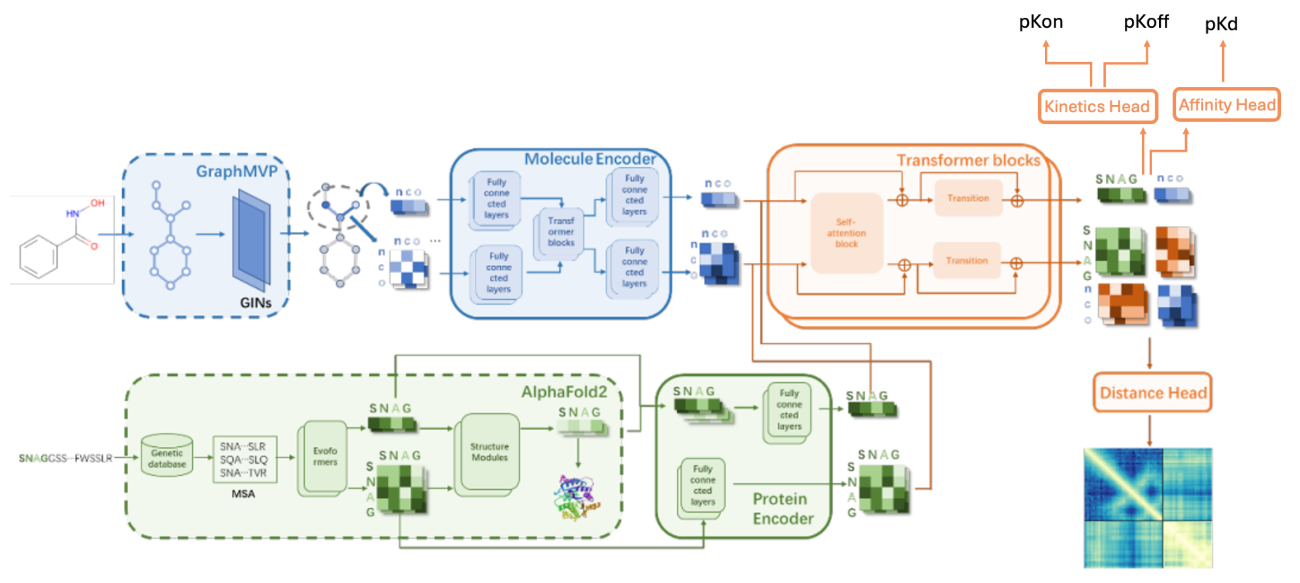
Sequence-based Binding Kinetics Prediction
Ligand-Transformer architecture
Adapted from Zhang et al. (2023)
Notes:
Now that we’ve defined some key terms, I’ll explain the Ligand-Transformer architecture a little bit more. As mentioned previously, the ligand transformer uses protein representations from AlphaFold2 and molecule representations from GraphMVP. The first stage of the model is to re-encode these representations using a combination of fully connected layers and transformer layers. Then, the model uses transformer blocks with self-attention layers with a pair bias. This just means there is an exchange of information between the protein and the molecule representations so a complex representation can be formed. Now, I want to draw your attention to the last block of the network: the prediction heads. In the original LT implementation, there are two major predictions heads: the distance head, which predicts the distance between the atoms of the protein and the molecules; and the affinity head, with predicts the binding affinity, pkD of the complex.
In very simple terms, what I did was to add another prediction head to the model. I’ll refer to this as the Kinetics Head for the remaining of the presentation. This head follows a very similar architecture to the Affinity head with the exception of the output layer, which has 2 nodes to predict two values: pKon and pKoff.

Slide 7
Sequence-based Binding Kinetics Prediction
Aims
Make use of PDBbind dataset (pKD) values and KIND dataset (pKD, pKon, pKoff)
Predict binding kinetics for unseen drug and targets
Notes:
Given this problem and the already existing model architecture, the project had three main aims:
We started this without a proper dataset in mind and so part of my internship was spent looking for experimental data on these three parameters: pKd, pKoff and pKon. Because it is very expensive and time-consuming to perform these experiments, datasets on these are scarce. However, I managed to find some data and we were happy to proceed with the project. The data is a collection from many different studies and because of the nature of these studies, many drugs are tested to the same protein and the same protein was tested against many drugs. This means it’s almost impossible to have unseen protein and ligand in the validation sets. Therefore, we did a preliminary test to see if we could predict the complexes still in the dataset, even though some information about the complex was already in the training set. Thereafter, we got creative and came up with some ways to test how well the Kinetics head performed on unseen data.

Slide 8
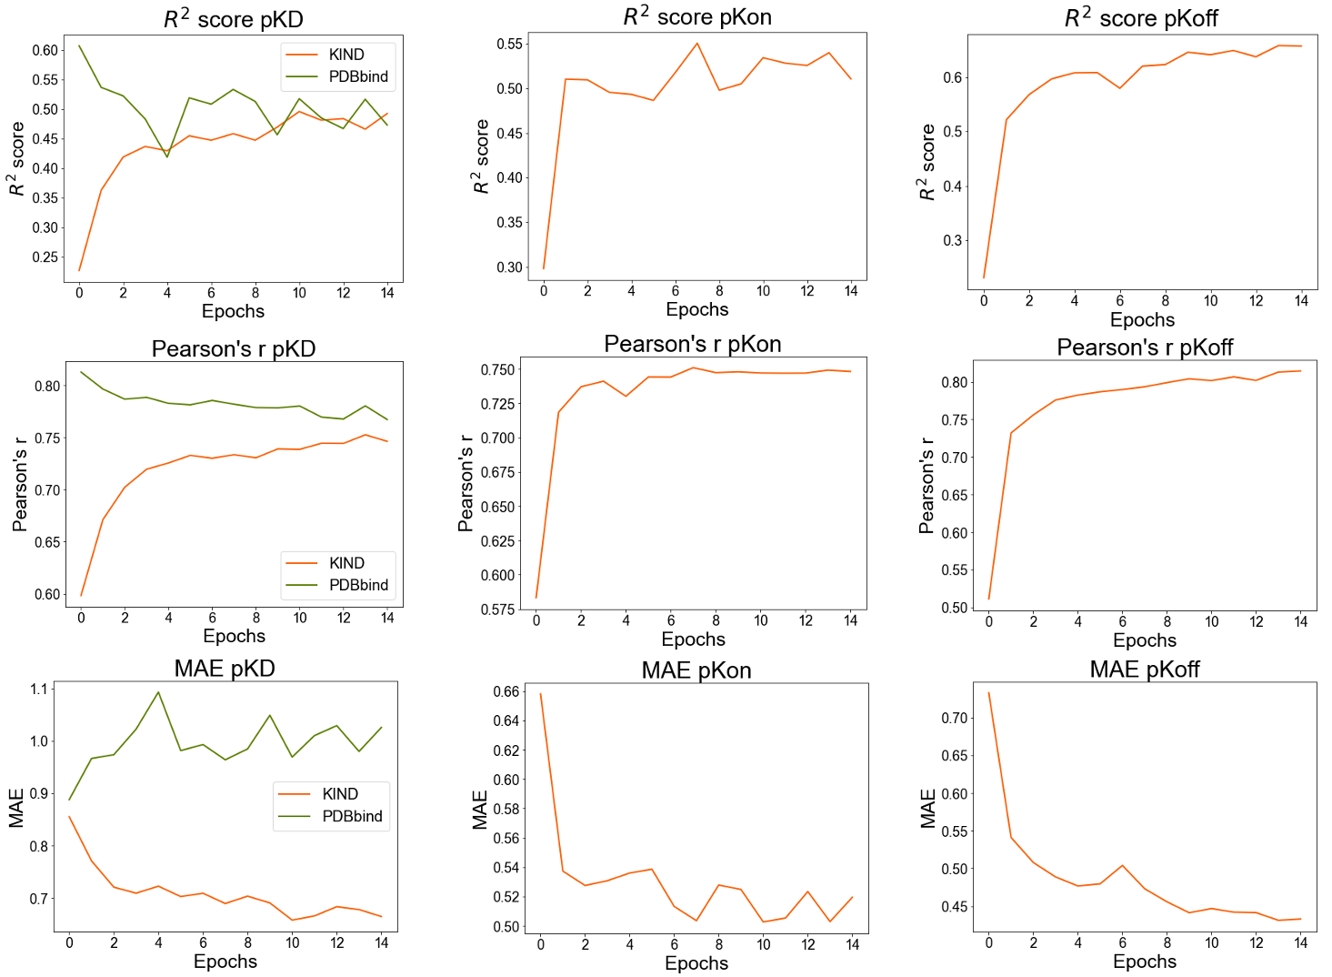
Sequence-based Binding Kinetics Prediction
2. Predict binding kinetics for unseen drug and targets
Model with KIND and PDBbind was trained for 15 additional epochs
Slight deterioration in performance for PDBbind, but convergence on all KIND measures

Slide 9
Sequence-based Binding Kinetics Prediction
2. Predict binding kinetics for unseen drug and targets
Binding affinity prediction methods for KIND and PDBbind
Terms | Definitions
True Affinity | pKD from the experimental dataset
True Calculated pKD | pKoff - pKon from experimental dataset
Predicted Affinity | pKD predicted from the Affinity Head
Predicted Calculated pKD | pKoff - pKon from prediction of Kinetics Head

Slide 10
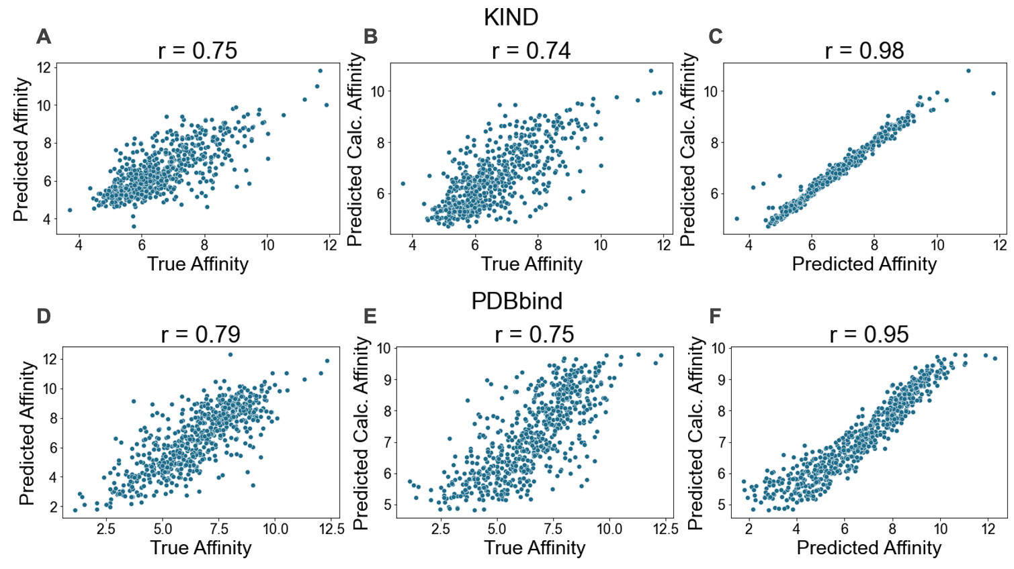
Sequence-based Binding Kinetics Prediction
2. Predict binding kinetics for unseen drug and targets
Binding affinity prediction methods for KIND and PDBbind
Affinity Head and Kinetics Head predict binding affinity for KIND and PDBbind

Slide 11
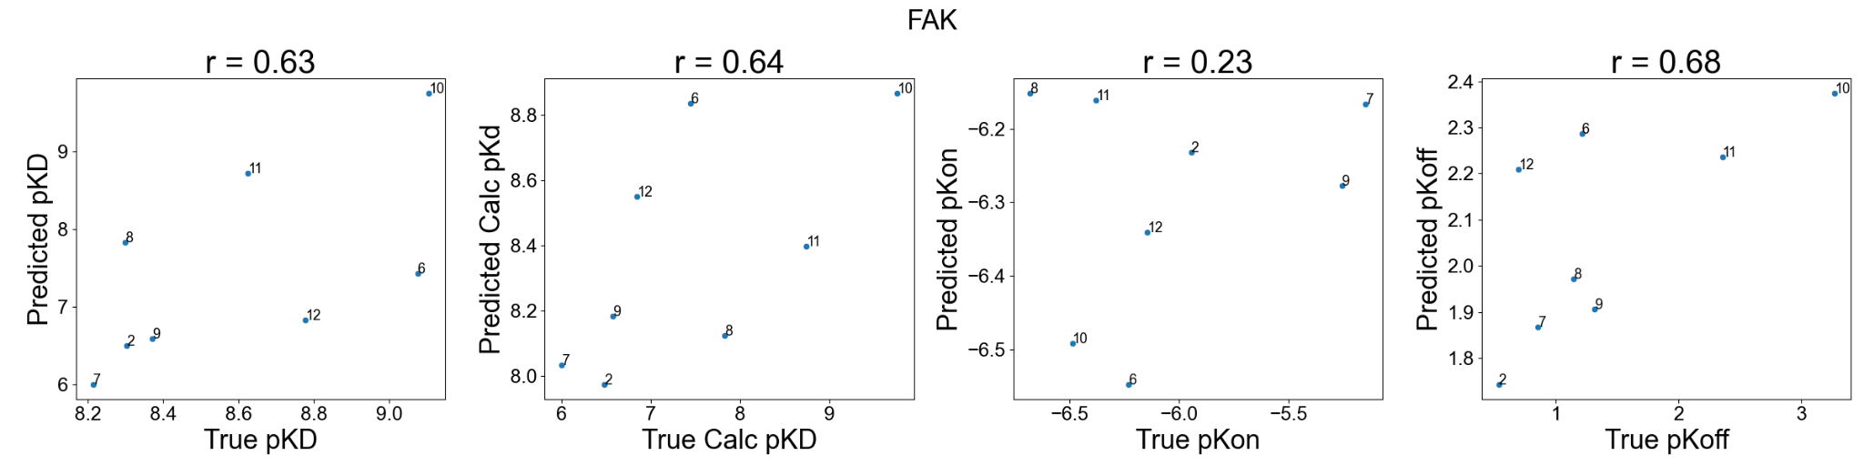
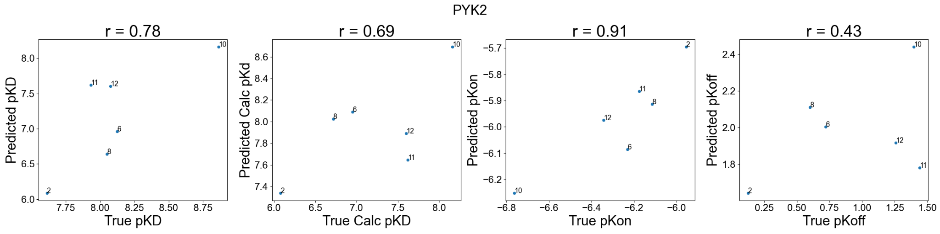
Sequence-based Binding Kinetics Prediction
2. Predict binding kinetics for unseen drug and targets
Independent test set used for validation (Berger et al. 2021)
Kinetics Head does not yet have consistent prediction accuracies for all proteins

Slide 12
A Case Study of Medin

Slide 13
A Case Study of Medin
Background & Motivation
Medin is an amyloid protein, which aggregates in less than 50 hours in vitro
The protein is associated with vascular dementia
Co-aggregated with amyloid-β (Aβ) in Alzheimer’s disease (AD);
Medin expression levels are correlated with severity of vascular Aβ in AD
No available drugs targeting medin

Slide 14
A Case Study of Medin
Aims
Explore the structure of Medin
Select 30 molecules with high binding affinity to Medin, to be tested experimentally in vitro
Characterise binding of these molecules to Medin
Binding site analysis
Molecular descriptors of strong binders
Specificity analysis

Slide 15
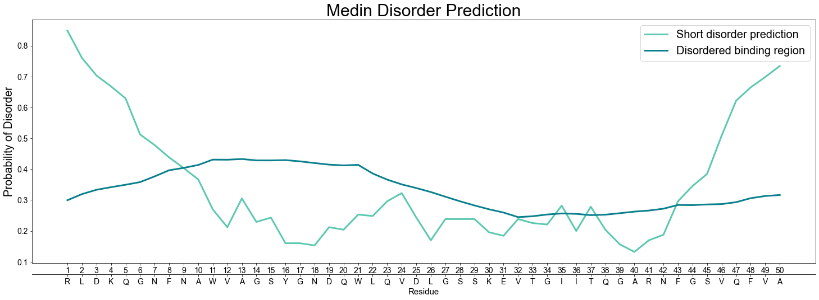
A Case Study of Medin
Explore the structure of Medin
IUPred2A for disorder prediction
Medin has few disordered regions, contrary to the literature

Slide 16
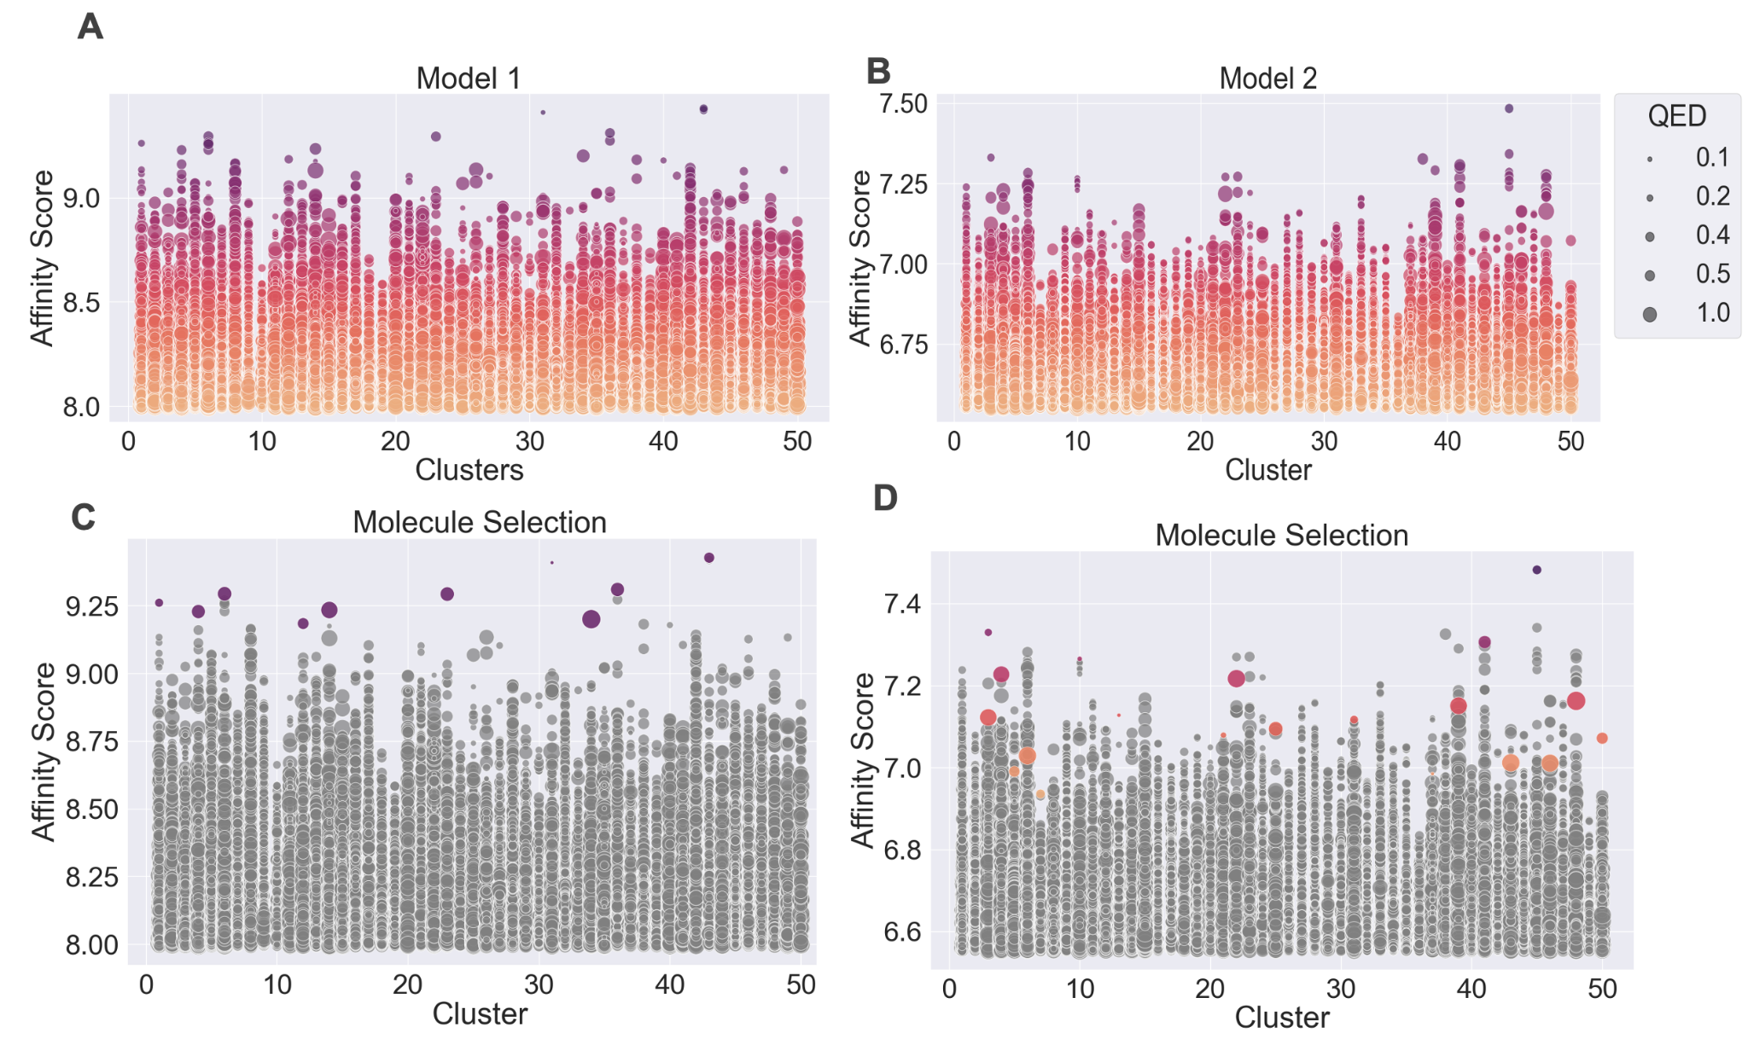
A Case Study of Medin
2. Select 30 molecules with high binding affinity to Medin
Ligand-Transformer used with ZINC dataset of purchasable compounds (~13 million)
Ligand-Transformer without (Model 1) and with (Model 2) hyperparameter optimisation
Butina Clustering for selection
D
A
Molecule selection was done according to predictions in Model 1 and Model 2

Slide 17
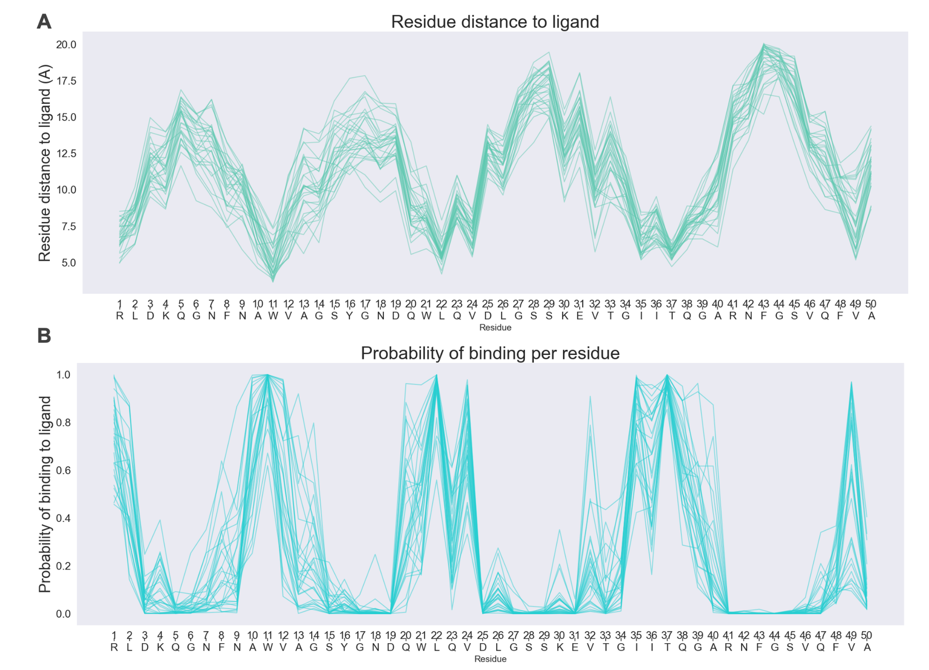
A Case Study of Medin
3. Characterise binding of these molecules to Medin
Binding site analysis
Distance Head of Ligand-Transformer was applied on the selected molecules
We find consistent binding sites across high-affinity molecules

Slide 18
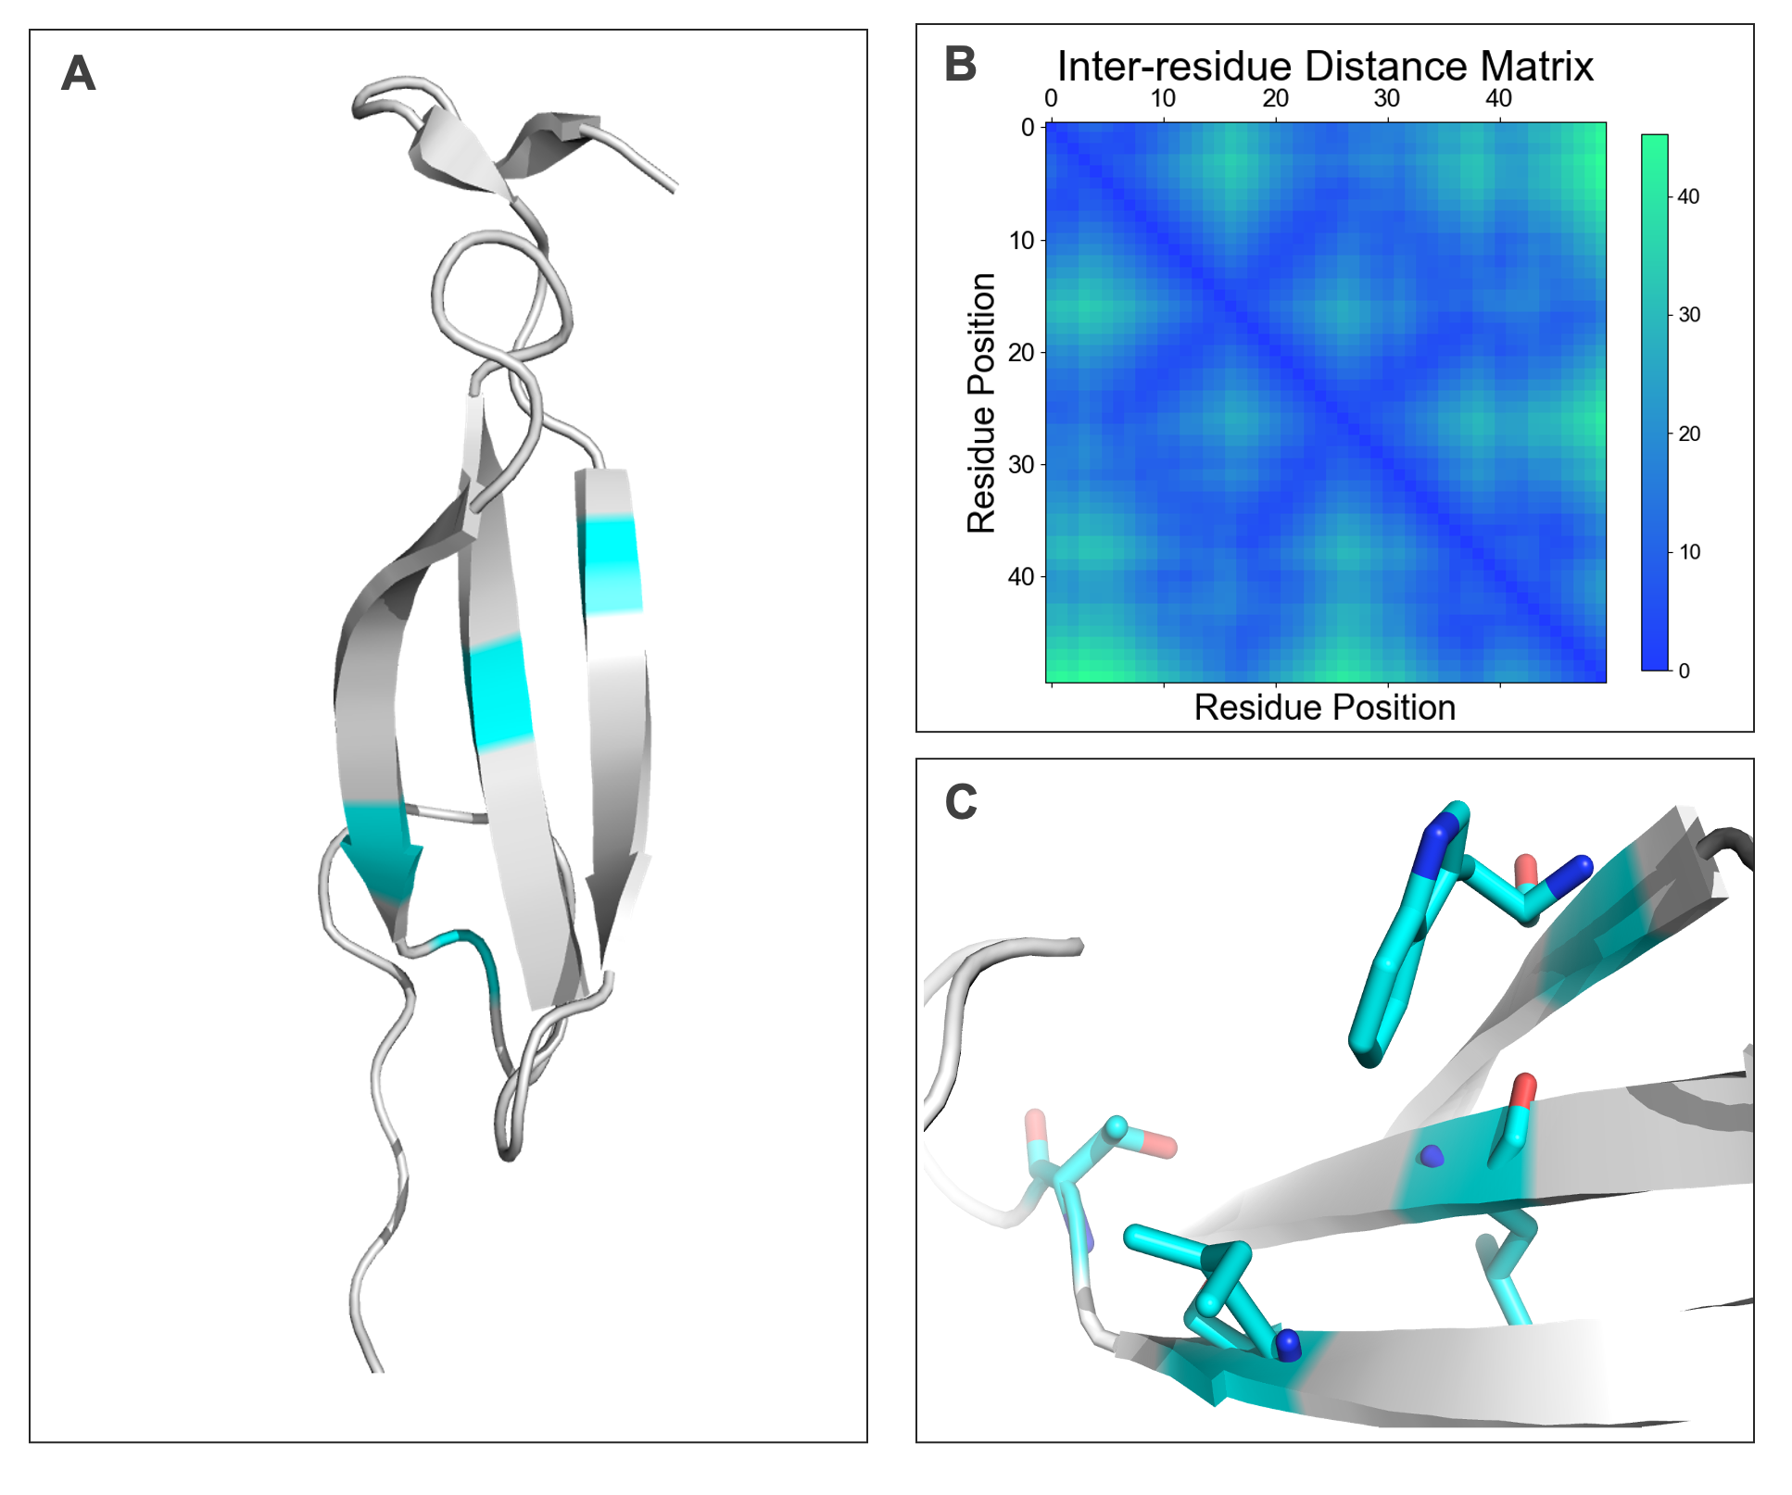
A Case Study of Medin
3. Characterise binding of these molecules to Medin
Binding site analysis
Davies et al. (2017) predicted Medin structure to visualise binding sites
Binding sites form a binding pocket across β-sheet hairpin

Slide 19
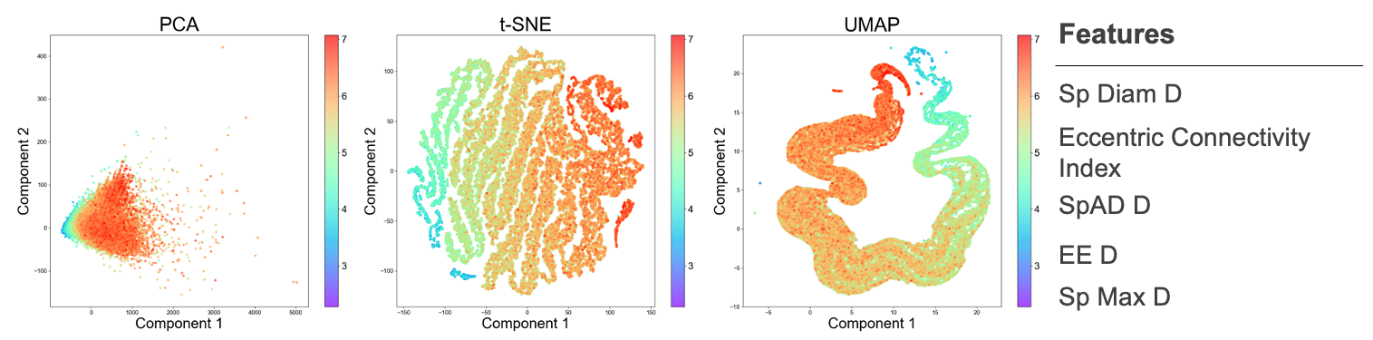
A Case Study of Medin
3. Characterise binding of these molecules to Medin
b. Molecular descriptors of strong binders
PaDEL descriptors predict over 1900 molecular descriptors for a given protein
Random Forest used for binding affinity prediction based on PaDEL descriptors
Topological distance matrix descriptors can explain binding affinity to Medin

Slide 20
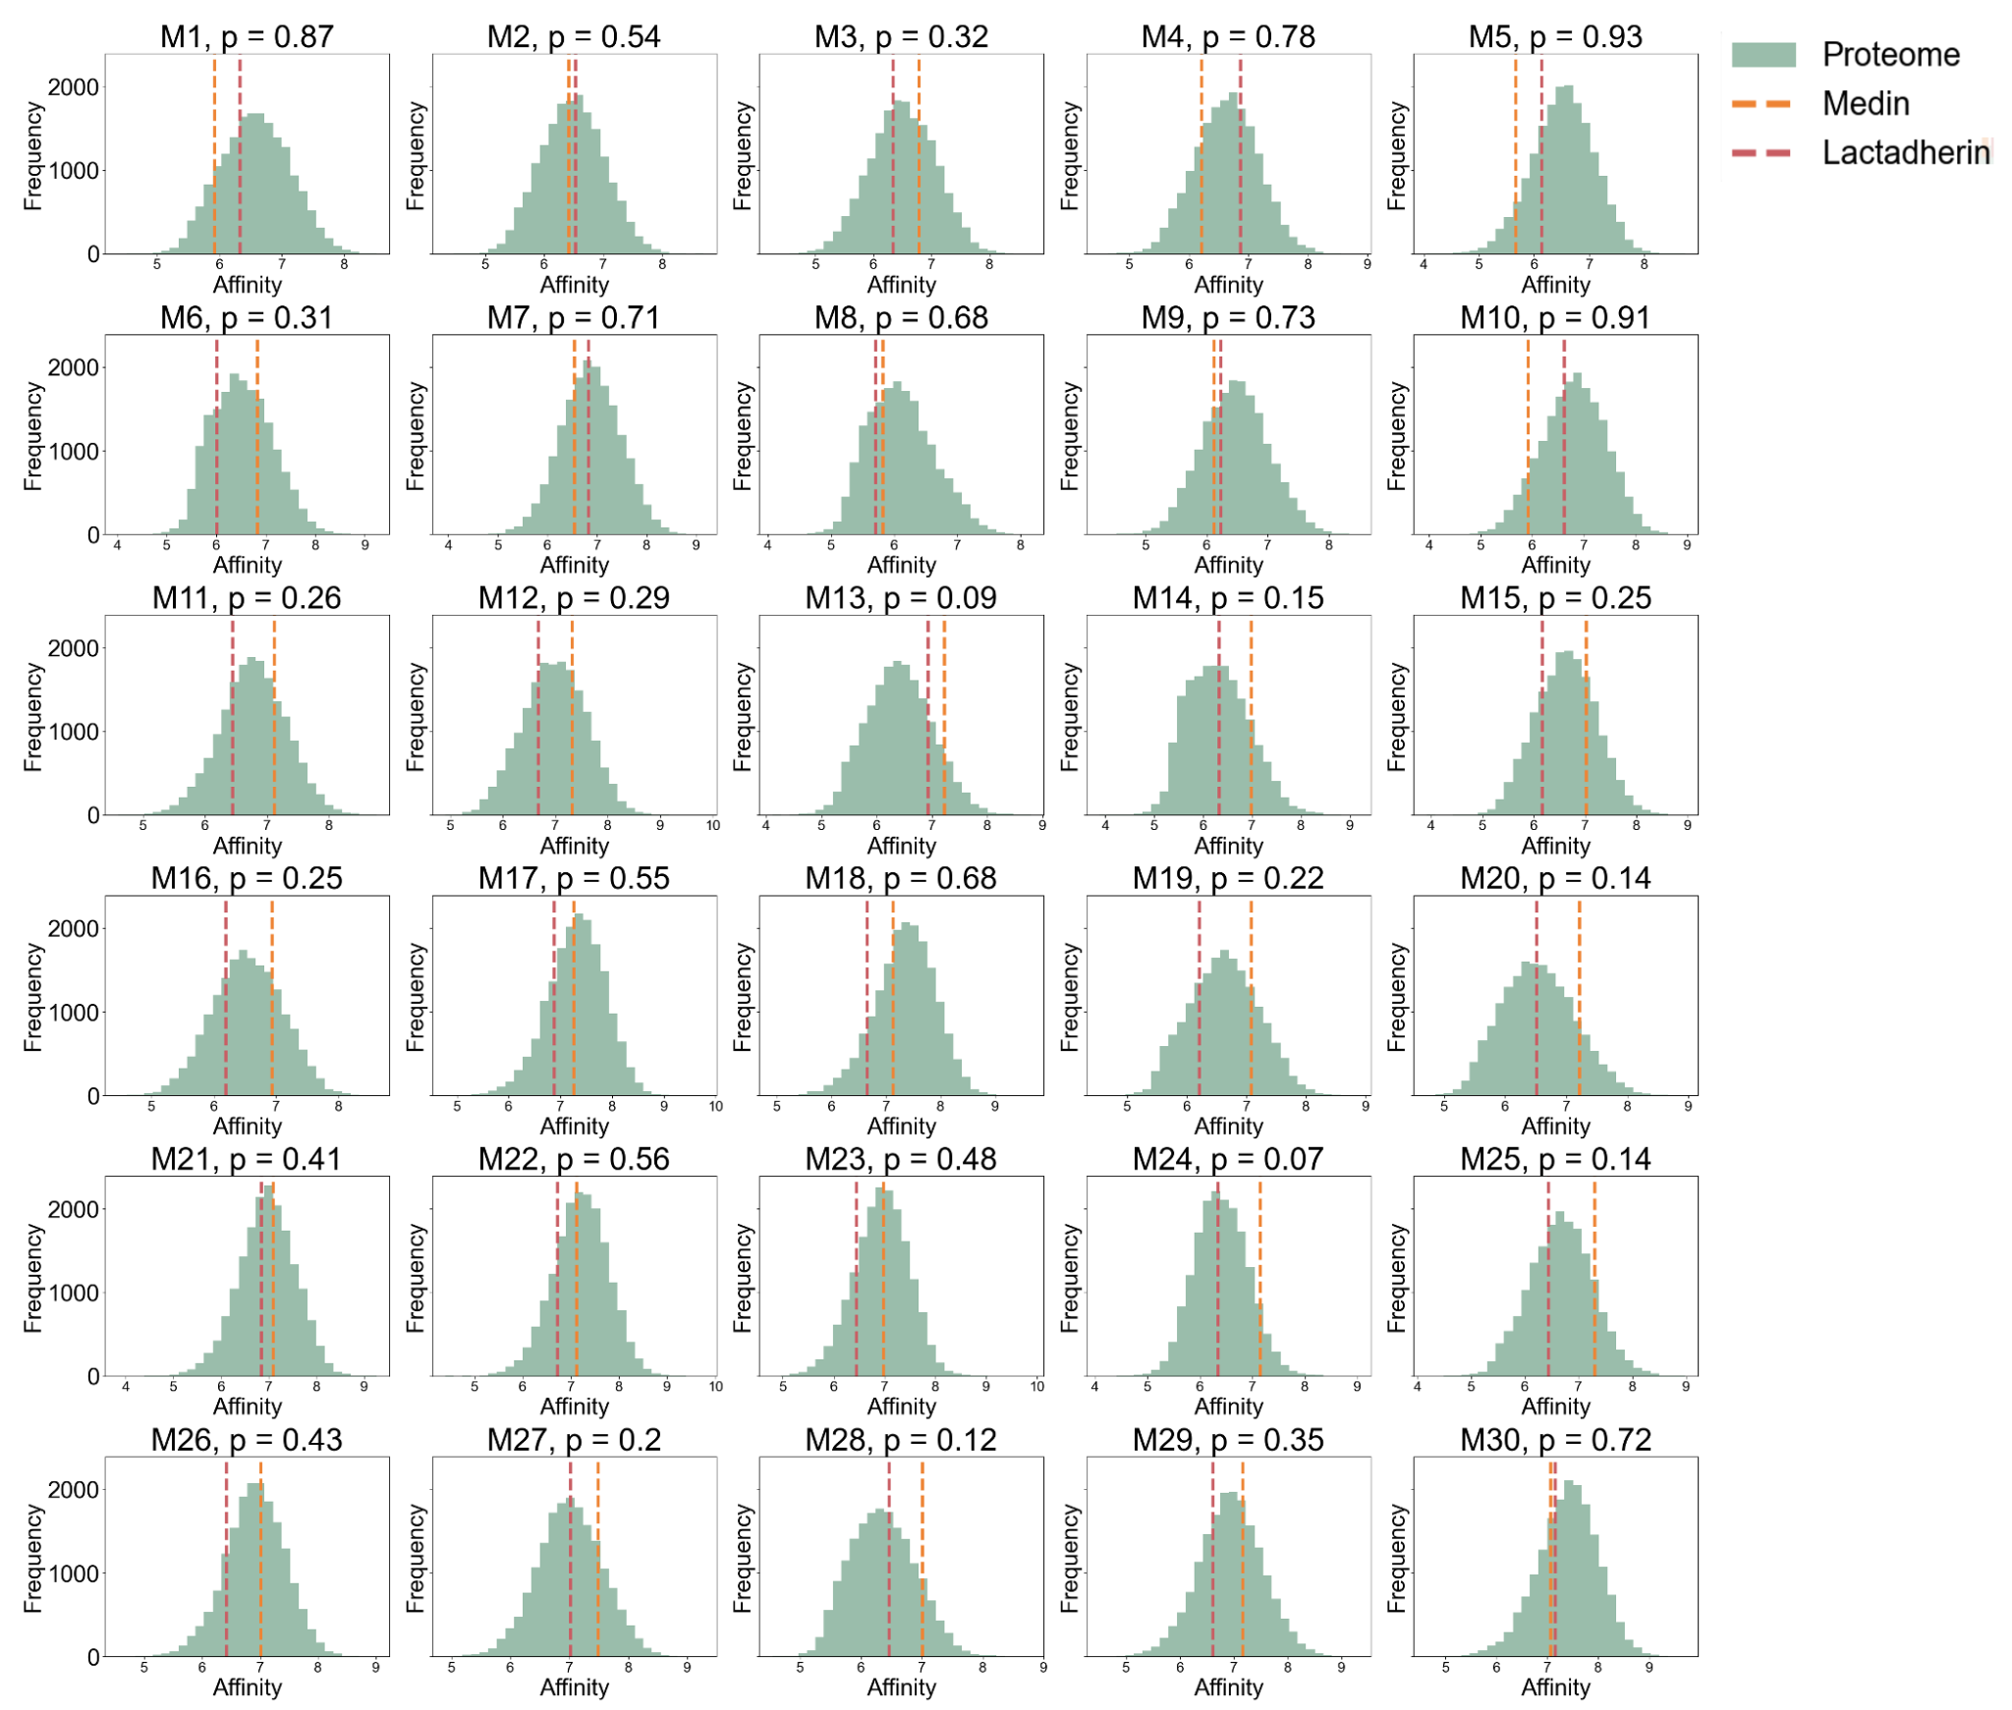
A Case Study of Medin
3. Characterise binding of these molecules to Medin
c. Specificity analysis
Ligand-Transformer screened selected molecules against the whole human proteome
Few molecules show specific binding to Medin

Slide 21
Conclusions & Future Directions
Correlation of experimental methods matches performance achieved for binding kinetics prediction
More experimental data is needed to improve model performance
In future, binding kinetics should be included in the drug discovery pipeline selection
Medin is a largely ordered protein, contrary to prior literature
Topological distance matrix descriptors have a nonlinear relationship with binding affinity
Target specificity should be included in the drug discovery pipeline

Slide 22
Acknowledgements
Michele Vendruscolo
Shengyu Zhang
Sebastian Pujaltes
Stephen Eglen
Samantha Noel

Slide 23
References
https://www.nature.com/articles/s41586-021-03819-2
https://www.biorxiv.org/content/10.1101/2023.11.27.568880v1.full.pdf
https://www.sciencedirect.com/science/article/pii/S2451945621000039
https://pubmed.ncbi.nlm.nih.gov/33183000/
https://pubs.rsc.org/en/content/articlelanding/2020/md/d0md00178c
https://www.nature.com/articles/s41586-022-05440-3
https://www.nature.com/articles/srep45224

Slide 24
Extra slides

Slide 25
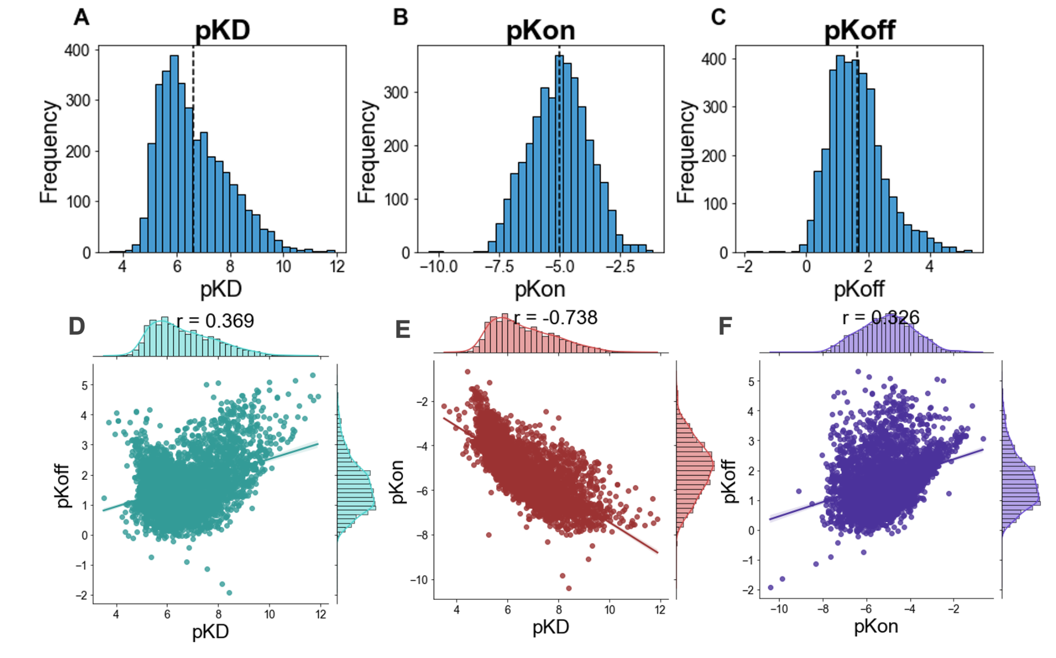
Sequence-based Binding Kinetics Prediction
Collect binding kinetics data
Total of 3537 complexes collected from KIND and Fedorov et al.
There is a strong association between pKD and pKon.
Notes:
So just to show a little bit about the dataset we found. Around 3537 complexes in total were used in the study from two main sources, KIND and Fedorov et al. These datasets were compiled from around 30 sources combined. Here are some of the distributions of the parameters and the correlations between these binding kinetics parameters. We can see a strong correlation between pKD and pKon, which indicates that high binding affinity is related to rapid binding drug rates.

Slide 26
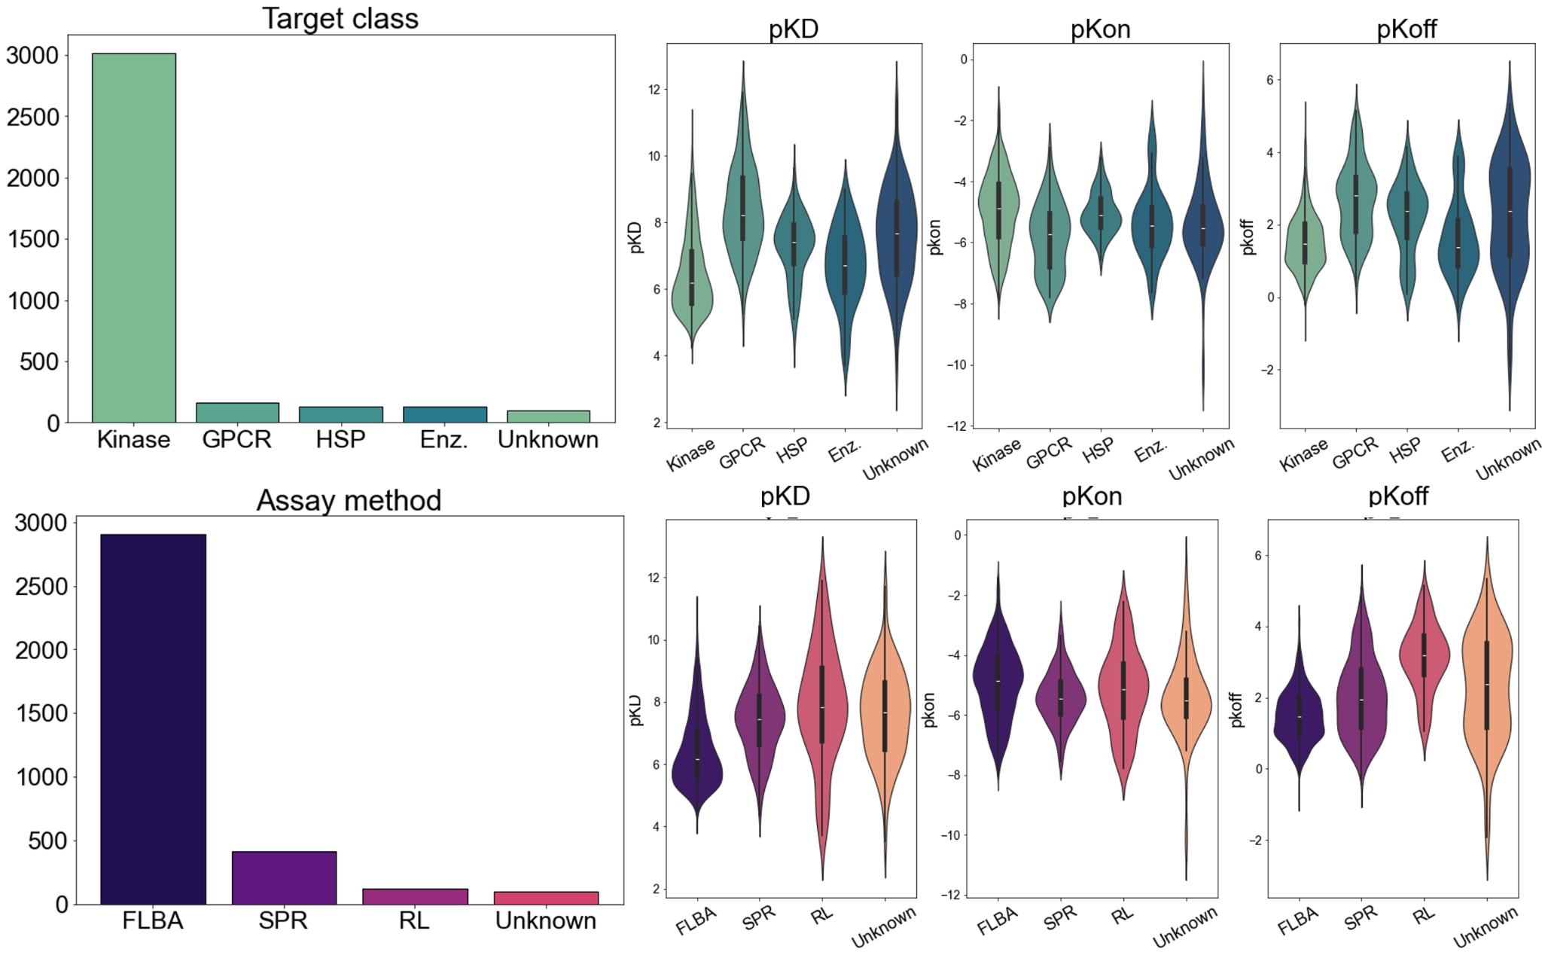
Sequence-based Binding Kinetics Prediction
Collect binding kinetics data
Data separated into 5 stratified folds for cross-validation
Difference in parameter distribution according to assay method
Notes:
We also had some meta data about the experiments, including the type of protein used in the assay as well as the type of experiment used. Some of these didn’t have the accompanying information, and were labelled as “unknown”. I want to especially draw your attention to the difference in distribution of hte parameters according to the different assay types here. We cna see the type of experiment seems to have a role in the prediction of the parameters. Overall, this information was used to split the data into stratified folds for cross-validation

Slide 27
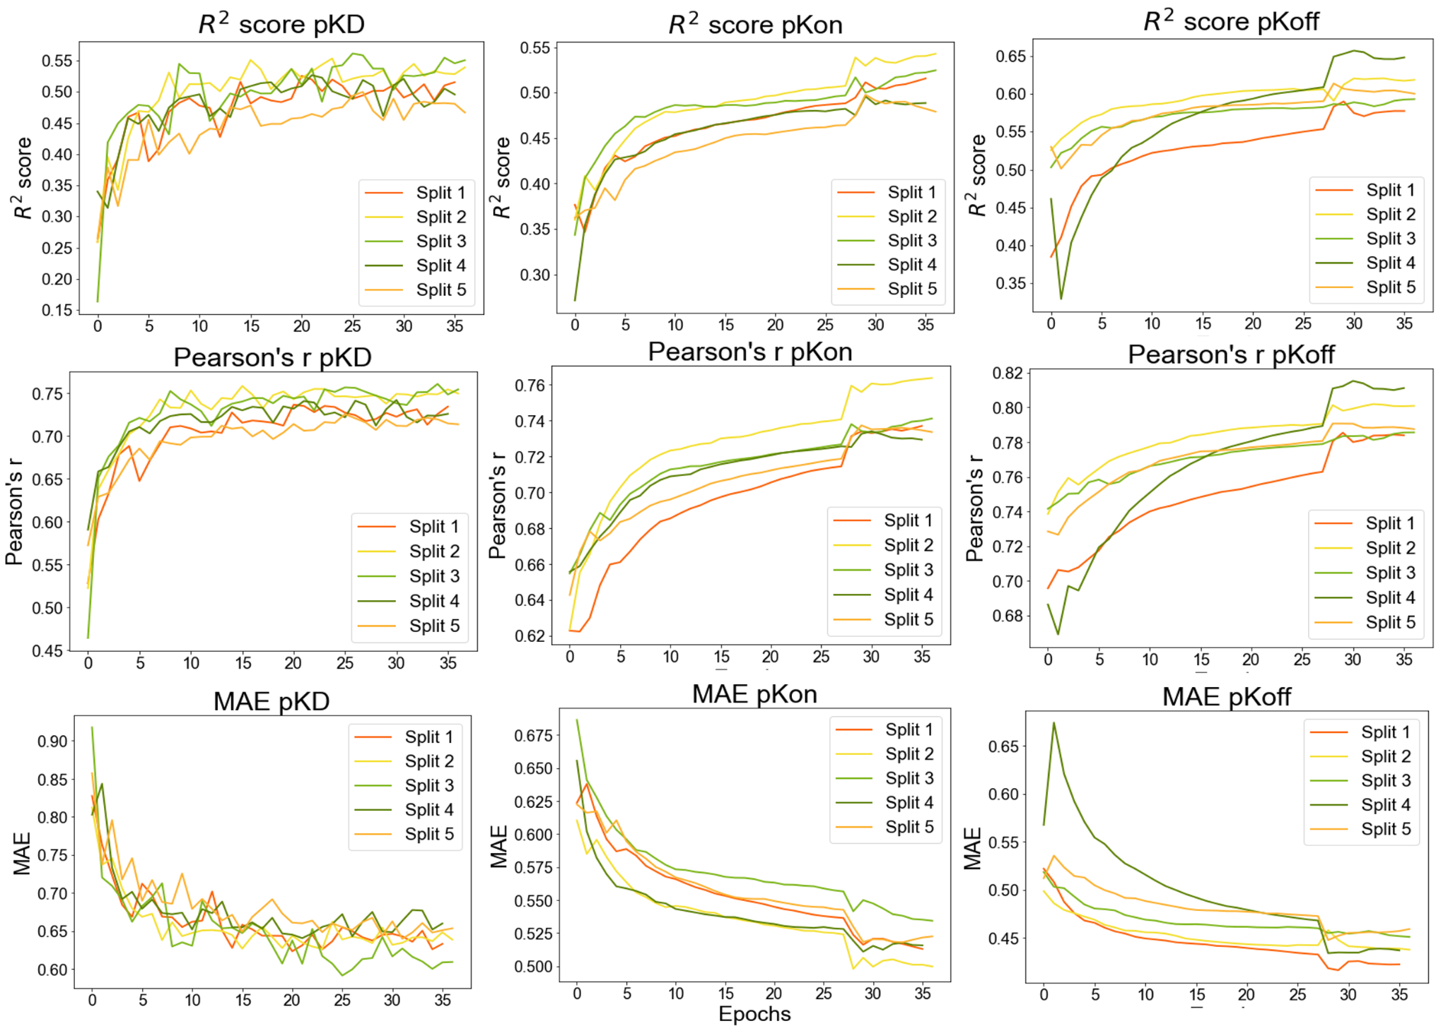
Sequence-based Binding Kinetics Prediction
1. Predict binding kinetics for drug or target in training
Model was finetuned only with KIND dataset for 30 more epochs
Model converges across all splits of cross-validation

Slide 28
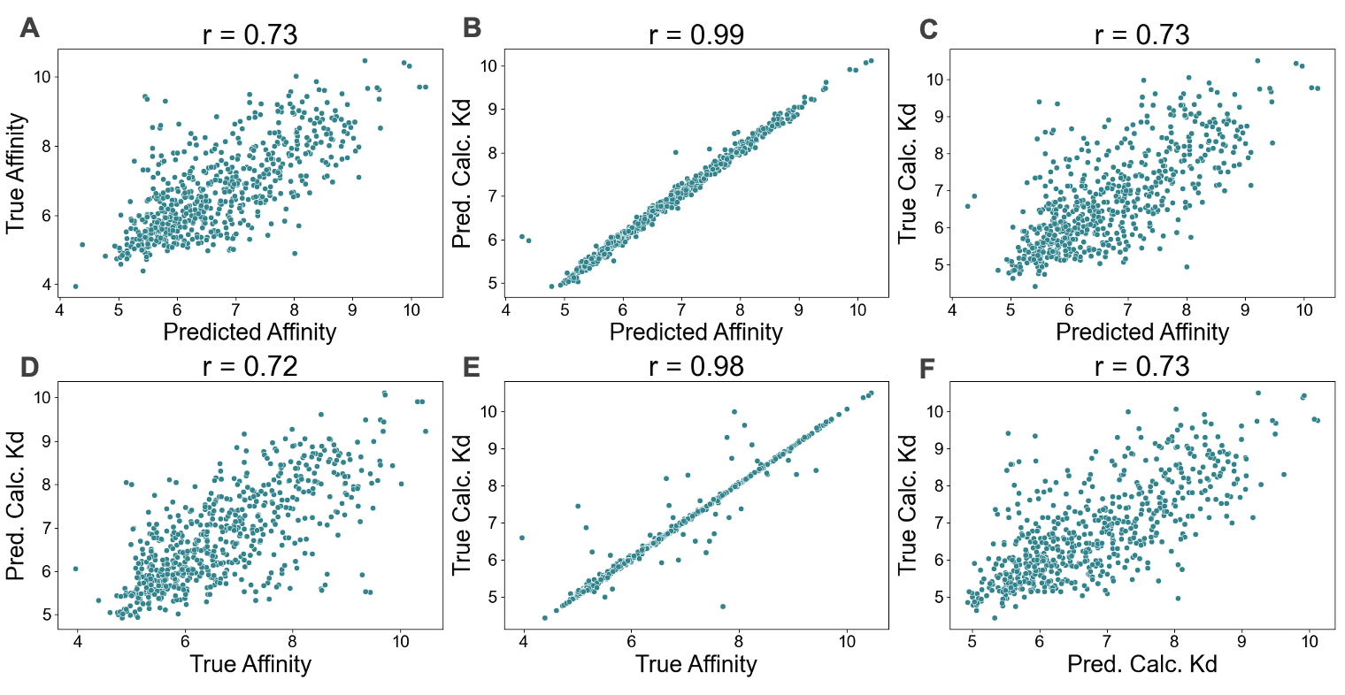
Sequence-based Binding Kinetics Prediction
1. Predict binding kinetics for drug or target in training
Binding affinity prediction with Kinetics Head or Affinity Head
Affinity Head and Kinetics Head predict binding affinity with similar performance for KIND dataset

Slide 29
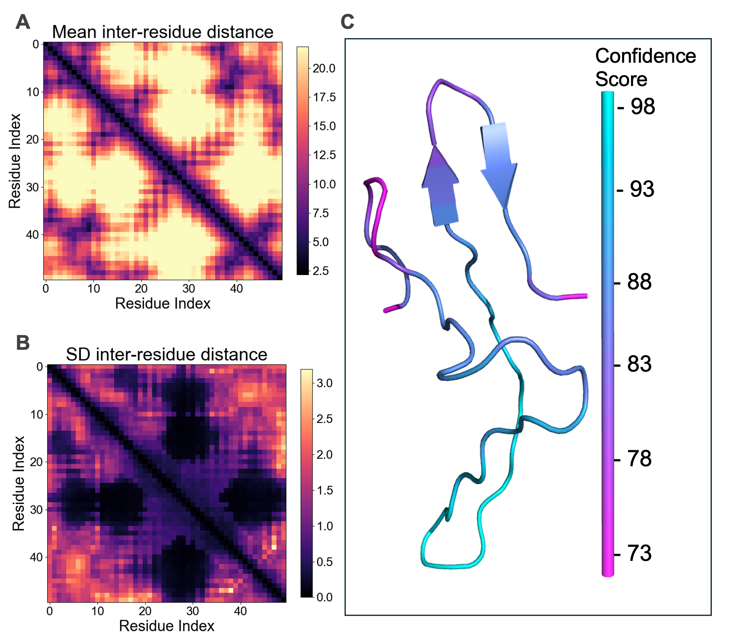
A Case Study of Medin
Explore the structure of Medin
ColabFold used to predict inter-residue distance matrix for Medin
AlphaFold2 has relatively high confidence in Medin structure, with exception of the termini

Slide 30
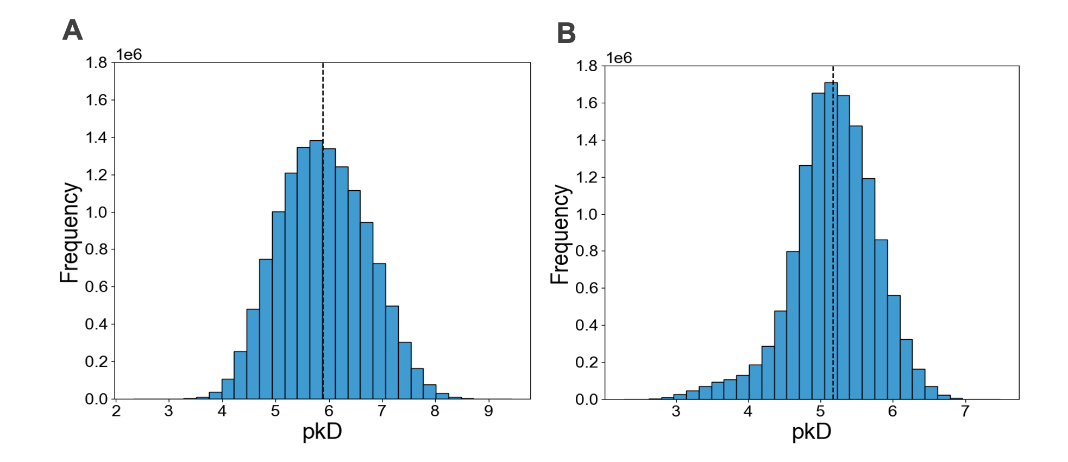
A Case Study of Medin
2. Select 30 molecules with high binding affinity to Medin
Ligand-Transformer without (Model 1) and with (Model 2) hyperparameter optimisation
Model 2 has a higher concentration of mid-affinity molecules

Slide 31
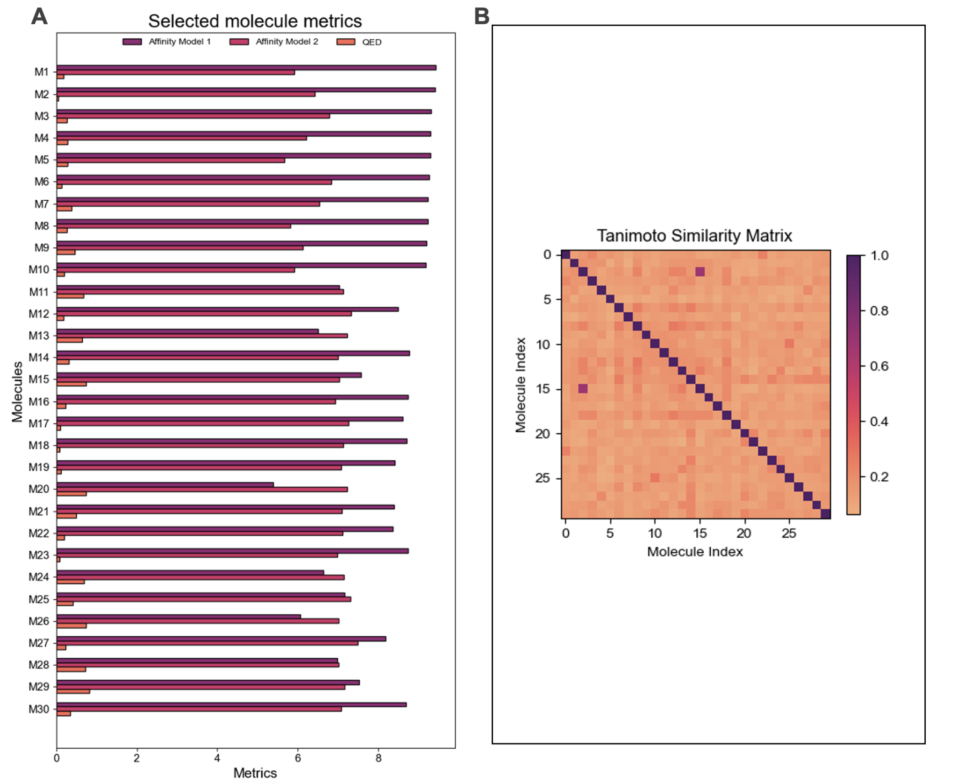
A Case Study of Medin
2. Select 30 molecules with high binding affinity to Medin
Tanimoto Similarity Index for selected molecules
Final molecule selection had a range of affinities in both models and were different amongst themselves

Slide 32
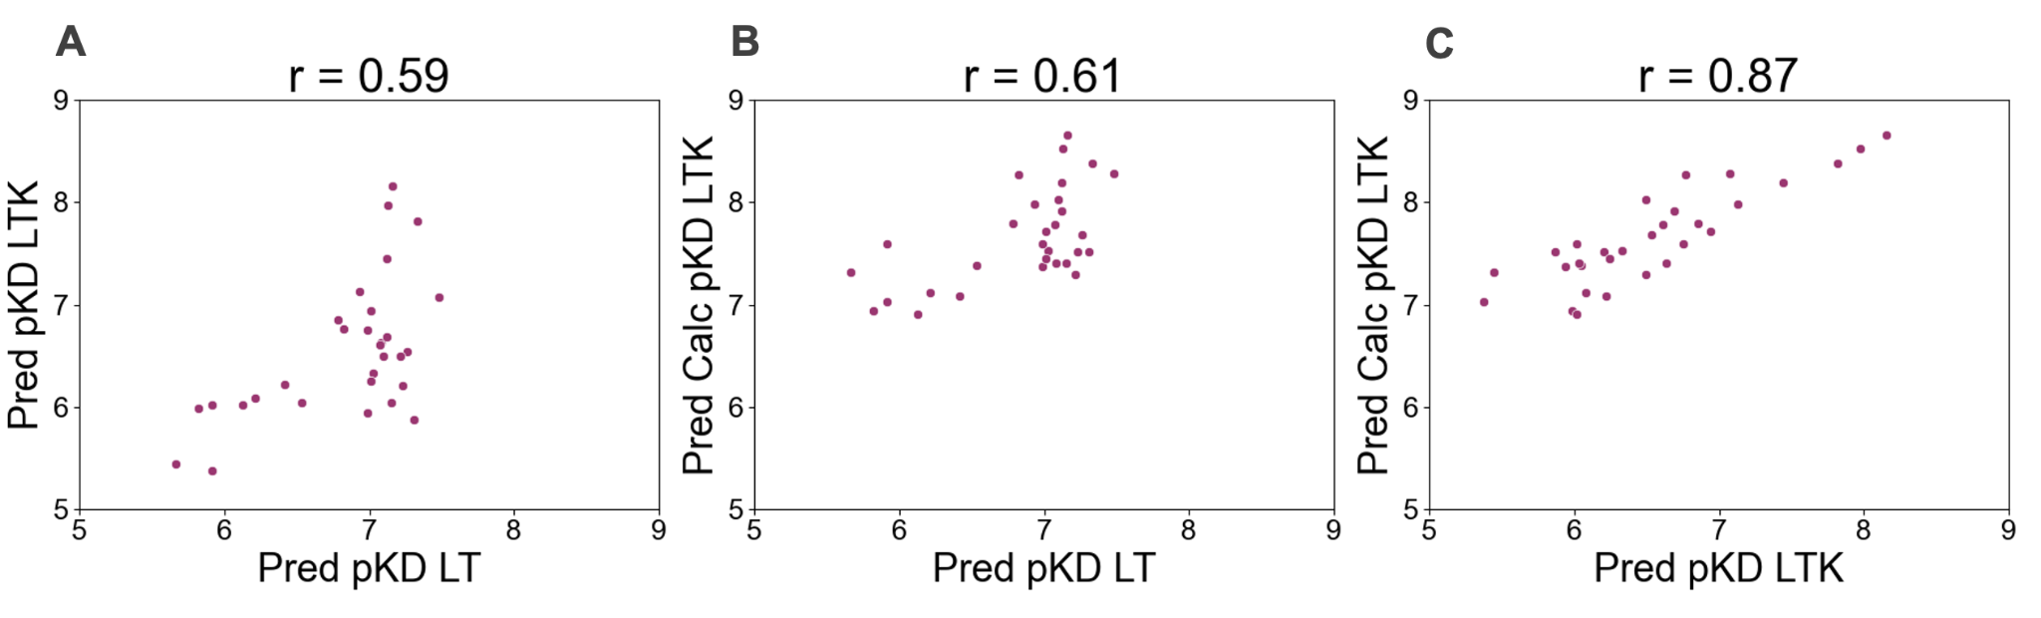
A Case Study of Medin
2. Select 30 molecules with high binding affinity to Medin
Kinetics prediction for selected molecules
Binding Kinetics prediction still does not present perfect correlation with Affinity Head

Slide 33
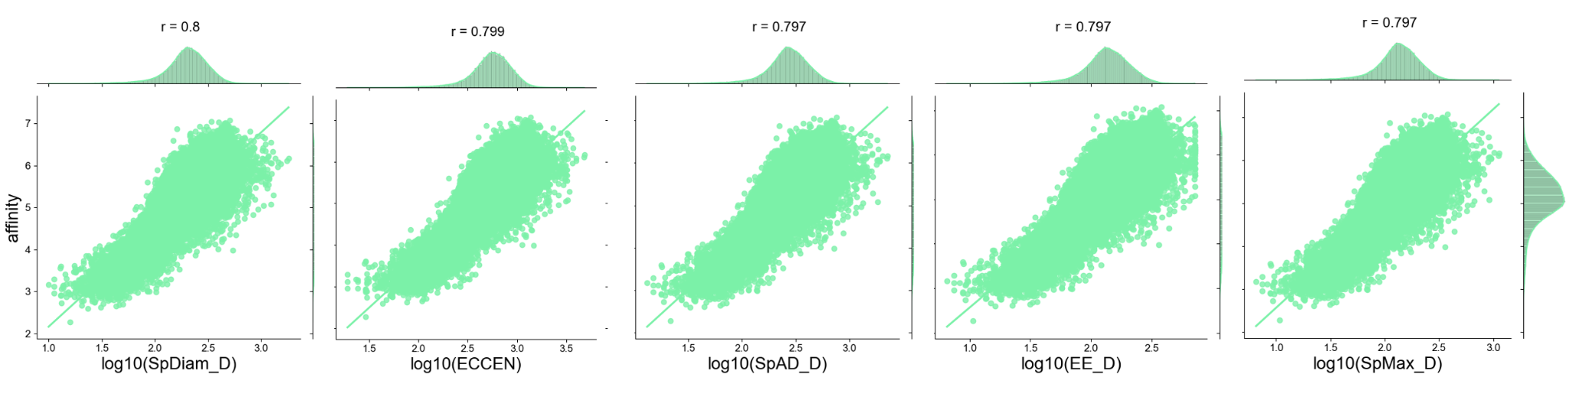
A Case Study of Medin
3. Characterise binding of these molecules to Medin
b. Molecular descriptors of strong binders
Relationship between top 5 descriptors and binding affinity
Log10 of topological descriptors are linearly correlated with binding affinity to Medin

